Slide 1
Yelp Review Annotation Project
Justin, Kelley and Yuan

Slide 2
Agenda
Review on task goals and annotation specification
Characteristics of the dataset
IAA at different aspects/levels and their interpretation
Metrics used and justification behind them
Interpretation and error analysis of the agreements
Machine learning experiment
Experiment design
Features extracted from the annotation
Experiment results

Slide 3
Task Goals
Annotation for Machine Learning Purpose: extract food’s quality from Yelp restaurant reviews (Sentiment Analysis over food items)
Mexican Food: among top five most reviewed restaurant categories
Restaurant Type | Number of Reviews
Nightlife | 212,618
Bars | 205,693
American (new) | 187,984
American (Traditional) | 182,300
Mexican | 144,727

Slide 4
Annotation Specification
Extent Tags:
Food Items
Quality (Positive, Negative, Neutral)
Anaphora
Linked Tags:
Part-of
Opinion (Explicit and Implicit)
Coreference
Notes:
Explicit: The tacos there are SO goodpositive. Implicit: Don’t order the chicken… The enchilada here is overpriced negative.

Slide 5
Annotation Specification
Example:
The carnitas taco[food] was SO good[quality]. It[anaphor] comes on a soft shell taco[food] with pico de gallo[food] and guacamole[food].
SO goodpositive opinion(explicit) carnitas taco coreference It
Part-of
soft shell taco pico de gallo guacamole

Slide 6
Dataset Characteristics
used reviews from round 7 of the annual yelp dataset challenge
Calico Jack’s 143 reviews GS: 72 reviews avg. ~ 1.5⭐
Carlos O’Brien’s 120 reviews GS: 84 reviews ~ 3.4⭐
Mi Amigos 115 reviews GS: 76 reviews ~ 3.0 ⭐
Roberto’s 166 reviews GS: 113 reviews ~4.0⭐
1: 73, 2: 63, 3: 82, 4: 88, 5:85
total words : ~41119
average words per review : ~ 120

Slide 7
Inter-Annotator Agreement
Extent Tags | Krippendorff's Alpha
FOOD | 0.6653
QUALITY | 0.5306
QUALITY: type | 0.6780
ANAPHORA | 0.4394
Cross-tag | 0.5562

Slide 8
IAA Analysis
Used Krippendorff’s Alpha in order to account for span of extent tags
Some possible problems due to food/anaphora
Need to clarify whether articles should be included in food/anaphora tags

Slide 9
Machine Learning Experiments
Name Entity Recognition
Sentiment Analysis
Future work:
Food Ontology Learning
Reference Resolution

Slide 10
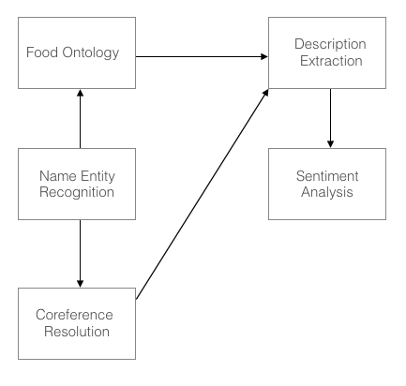
ML Experiments - Proposed Project Pipeline

Slide 11
Name Entity Recognition
Baseline:
micro-precision = 36.9%
micro-recall = 30.6%
Approach:
Matched foods from wikipedia list of mexican foods
Used a regular expression to allow for plurals
Need to revise to account for problems with span
“Al Pastor Tacos” is tagged as “Al Pastor” and “tacos”

Slide 12
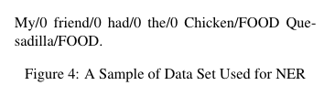

Name Entity Recognition Cont.
Use Stanford NER [Finkel et al. 2005] to train a CRF model to identify Mexican food names.

Slide 13
Description Sentiment Analysis
Extracted each distinct food name in a restaurant, as well as its descriptions.
To make evaluation simpler, we decided that:
a positive description adds 1 point
a negative description subtracts 1 point
If sum > 0, then the overall quality of the food is positive; if sum < 0, the that will be negative.

Slide 14
Description Sentiment Analysis Cont.
Baseline: assign foods pos/neg based on the star rating of the reviews they appear in
~ 30% of extracted foods correctly rated
Approach:
Naive Bayes
Very bad results ~15% correctly labeled
Classifying based on average of star rating of reviews food appears in
Better results ~30%

Slide 15
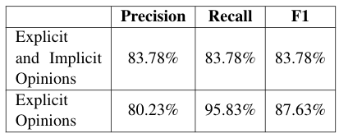
Description Sentiment Analysis Cont.
Extract all the description words (excluding neutral), and used them as features to train on SVM^{light}[Joachims, 1991] to classify the sentiment of descriptions.

Slide 16
Description Sentiment Analysis Cont.
Explicit and Implicit Opinions (amalgamated on each food item):
Accuracy on test set: 84.62% (44 correct, 8 incorrect, 52 total)
Precision/recall on test set: 91.89%/87.18%
F measure: 89.47%
Explicit Opinions (amalgamated on each food item):
Accuracy on test set: 93.18% (41 correct, 3 incorrect, 44 total)
Precision/recall on test set: 96.97%/94.12%
F measure: 95.52%

Slide 17
Future Work
If we had more time, data and knowledge in CL...

Slide 18
Food Ontology Learning
Find the right ontology of food items, and so the description about the ingredients of a food item would be attributed to it.
For example: The beans are good, and the beans are part of a burrito. Thus, the burrito should be good, too.

Slide 19
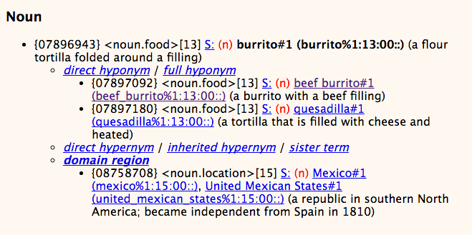
Food Ontology Learning Cont.
What about WordNet[Princeton, 2010]? -- We need meronyms!

Slide 20
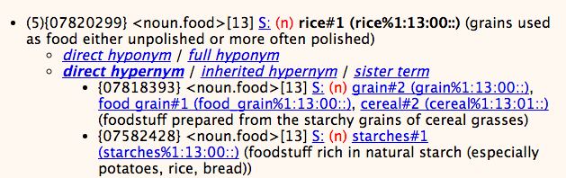
Food Ontology Learning Cont.

Slide 21
Food Ontology Learning Cont.
There are two possible approaches [Lehmann & Voelker, 2014]:
Logical Learning
“derive ontologies from structured knowledge”
Lexical Learning
“Ontology learning from natural language text based on information extraction and text mining techniques”
Either way, we currently do not have enough data to work on it, because the average frequency of a food name is only 2.

Slide 22
Reference Resolution
Finding all expressions that refer to the same food entity. This is important because we want to collect all the information relevant to the food.
Example:
After trying to find some good queso[food] in the Valley with very little success, I finally found the good stuff at Carlos O'Brien's. It [anaphor] was delicious.

Slide 23
Reference Resolution
Existing packages (StanfordCoreNLP) focus on proper noun, places, persons, dates, etc.
not suitable for our purpose on recognizing food
not recognize foot names that appears multiple times
Coreference Baseline: precision 2.94%, recall 24.39%
Possible Solutions:
cluster-ranking approach to NP coreference (Rahman & Ng)
Combines entity-mention model and mention-ranking model (using SVM)
Notes:
I've been eating Carlos O'Brien's for over 15 years now and it's always awesome every time! I love the Pollo Fundito, pretty much what I get every time! Enchiladas are awesome too!

Slide 24
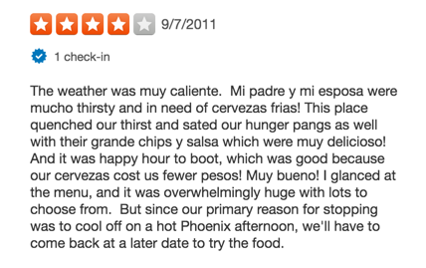
Corpus Processing
Spell check
yummmmy
Carne assada
Sentence segmentation
Tacos. Great.
Dealing with food names in English and Spanish
Great chips y salsa

Slide 25
Acknowledgment
This machine learning project could not have been attempted without the tireless efforts of our annotators, Xinhao Wang, Jose Ramirez, and Matthew Garber. The quality and commitment of their hard work is much appreciated, especially their unswerving persistence in reading through 1-star reviews on terrible Mexican food.

Slide 26
References
T. Joachims, Making large-Scale SVM Learning Practical. Advances in Kernel Methods - Support Vector Learning, B. Schölkopf and C. Burges and A. Smola (ed.), MIT-Press, 1999.
Jenny Rose Finkel, Trond Grenager, and Christopher Manning. 2005. Incorporating Non-local Information into Information Extraction Systems by Gibbs Sampling. Proceedings of the 43nd Annual Meeting of the Association for Computational Linguistics (ACL 2005), pp. 363-370.
Jens Lehmann, and Johanna Voelker (Eds.). Perspectives On Ontology Learning. Studies in the Semantic Web AKA / IOS Press, (2014)
Princeton University "About WordNet." WordNet. Princeton University. 2010. <http://wordnet.princeton.edu>

Slide 27
Reference
Marta Recasens, Marie-Catherine de Marneffe, and Christopher Potts. The Life and Death of Discourse Entities: Identifying Singleton Mentions.
In Proceedings of NAACL 2013.
Heeyoung Lee, Angel Chang, Yves Peirsman, Nathanael Chambers, Mihai Surdeanu and Dan Jurafsky. Deterministic coreference resolution based on entity-centric, precision-ranked rules. Computational Linguistics 39(4), 2013.
Heeyoung Lee, Yves Peirsman, Angel Chang, Nathanael Chambers, Mihai Surdeanu, Dan Jurafsky. Stanford's Multi-Pass Sieve Coreference Resolution System at the CoNLL-2011 Shared Task. In Proceedings of the CoNLL-2011 Shared Task, 2011.

Slide 28
Reference
Karthik Raghunathan, Heeyoung Lee, Sudarshan Rangarajan, Nathanael Chambers, Mihai Surdeanu, Dan Jurafsky, Christopher Manning. A Multi-Pass Sieve for Coreference Resolution EMNLP-2010, Boston, USA. 2010.
Altaf Rahman, Vincent Ng. Supervised Models for Coreference Resolution. Proceedings of the 2009 Conference on Empirical Methods in Natural Language Processing, pages 968–977, Singapore, 6-7 August 2009.

Slide 29
No Questions
Yes. No questions are allowed.

